Slide 1
Oh #$&! Perceptions of a Cursing Robot
Team Cursing
David Shin, Sarah Wagner, Shannon Yasuda

Slide 2
Background
Short et al. 2010
Cheating robot
social engagement
attributions of mental state
Litoiu et al. 2015
Controlling for cheating motion
Compared conditions of different cheating directions
Fraser, B. 1990
Cursing is considered a social norm violation
Notes:
What is it about cheating that elicits such heightened behavioral and perceptive responses to robot cheating? Is there something particular to adversarial cheating that triggers such a response? Or perhaps cheating belongs to a broader category of social norm violations that lead people to see robots as more human? We considered various alternative social norm violations that might help distinguish between such possibilities, including interrupting, and knocking over.

Slide 3
How does the violation of a social norm through cursing by a robot influence the way humans perceive that robot?
H1: A cursing robot elicits greater social engagement
H2: Participants perceive a cursing robot as more agentic

Slide 4
Methods
Our study included 32 participants aged 18-24: 14 male and 18 female. Each group played 30 rounds of rock, paper, scissors with Nao.
Experiment Group
16 participants
First 10 rounds: Normal
Second 10 rounds: The first time the robot lost, it would curse
Third 10 rounds: Normal
Control Group
16 participants
All 30 rounds were played normally. The robot never swore.

Slide 5
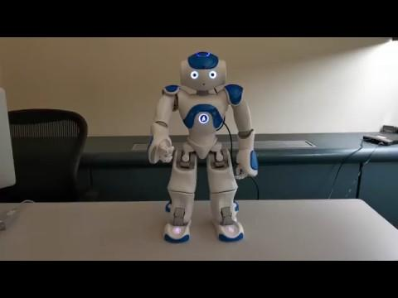
Notes:
Start at :24 to :39

Slide 6
Methods of Analysis
What we measured:
Whether or not a participant laughed during gameplay
Number of words spoken to the robot
Whether they used human adjectives/human pronouns to describe robot (anthropomorphization of robot)
Whether they used active verbs to describe the robot
Likert-scale survey responses
Tests we ran:
ANOVA, Welch-modified t-test

Slide 7
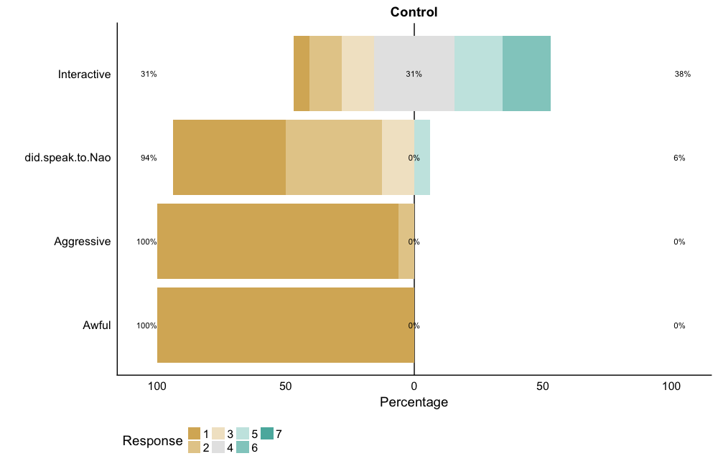
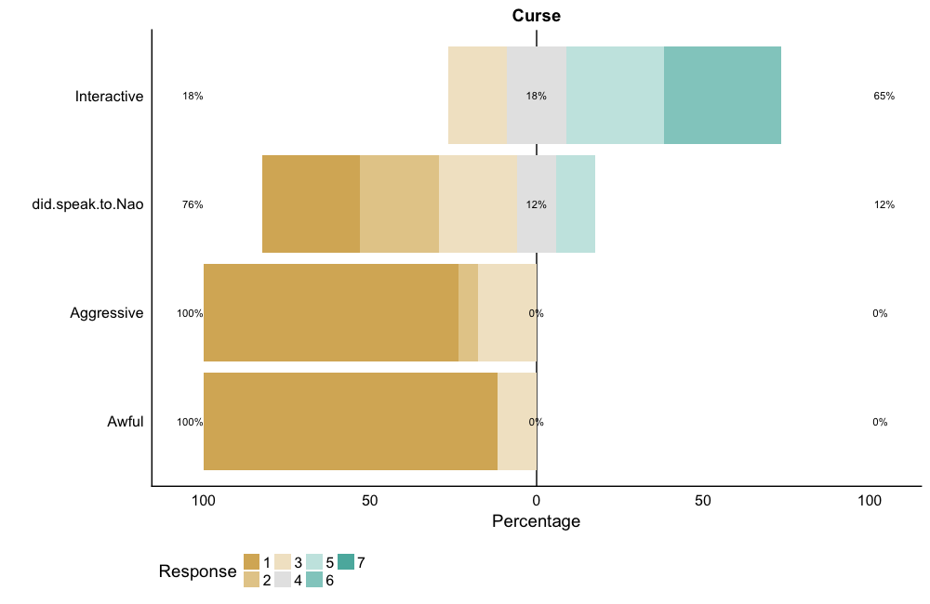
Results
Statistical Significance | ANOVA p-value | Welch-modified t-test p-value
Interactive | 0.184 | 0.116
Did Speak to Nao | 0.195 | 0.172
Aggressive | 0.219 | 0.095
Awful | 0.244 | 0.164
Notes:
Interactive:
Control: 31 vs. 38
Curse: 18 vs. 65
ANOVA covariates: gender, participant cursing, people they know cursng

Slide 8
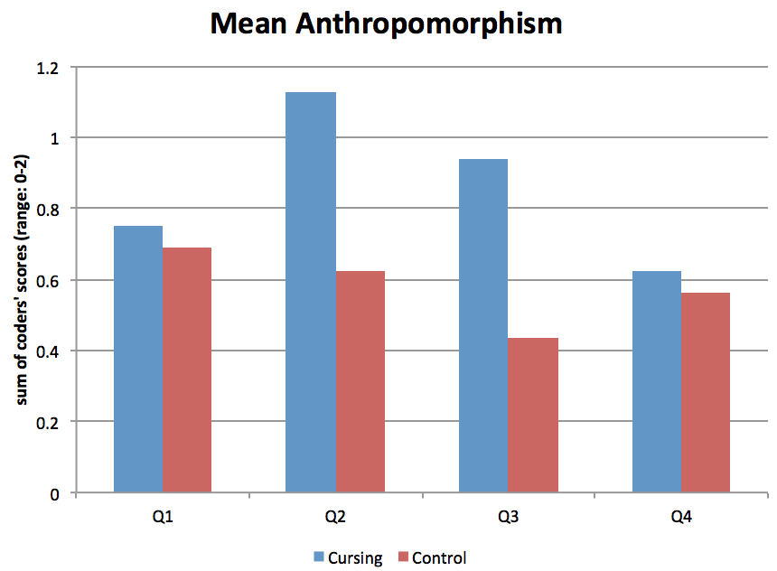
Anthropomorphism
-Coded for anthropomorphism based on whether participant used human pronouns (he, she, they) or used human-like adjectives (charming)
-For Q3, found significantly more anthropomorphism (p = 0.035 in ANOVA)
-Cohen’s Kappa for coding = 0.093
Notes:
Nothing statistically significant in active verbs
Q3: How well did Nao play the game?
“I think Nao said "f*ck" at one point which was surprisingly human”
“The most human thing he did was to say "oh f*ck"”

Slide 9
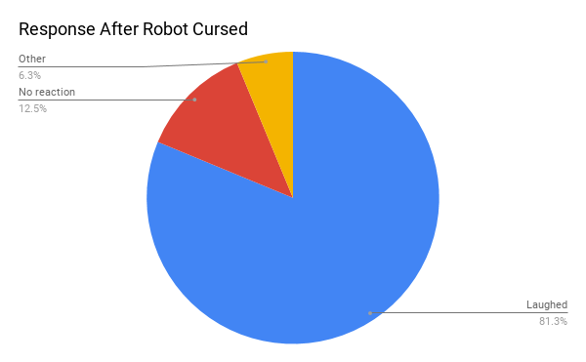
The Most Common Reaction: Laughing

Slide 10


Slide 11
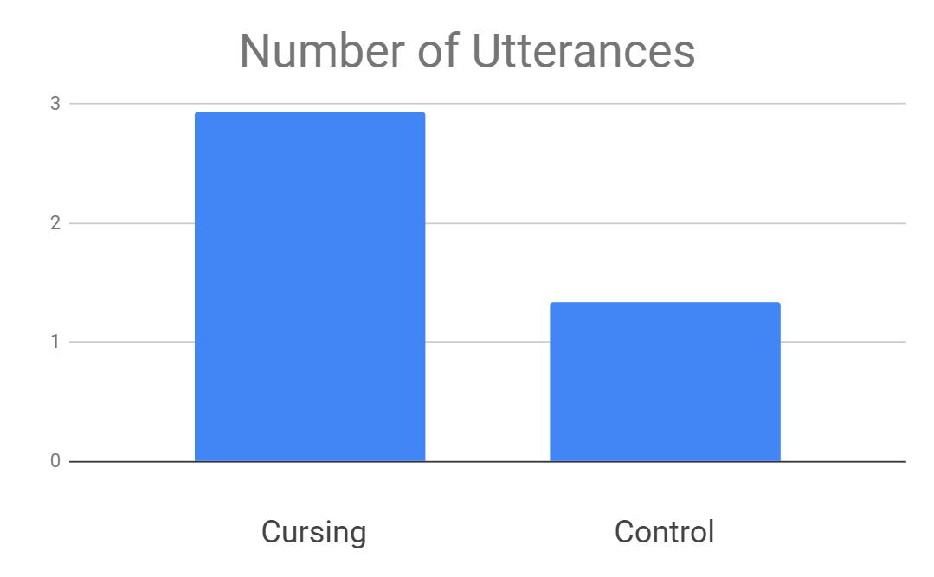
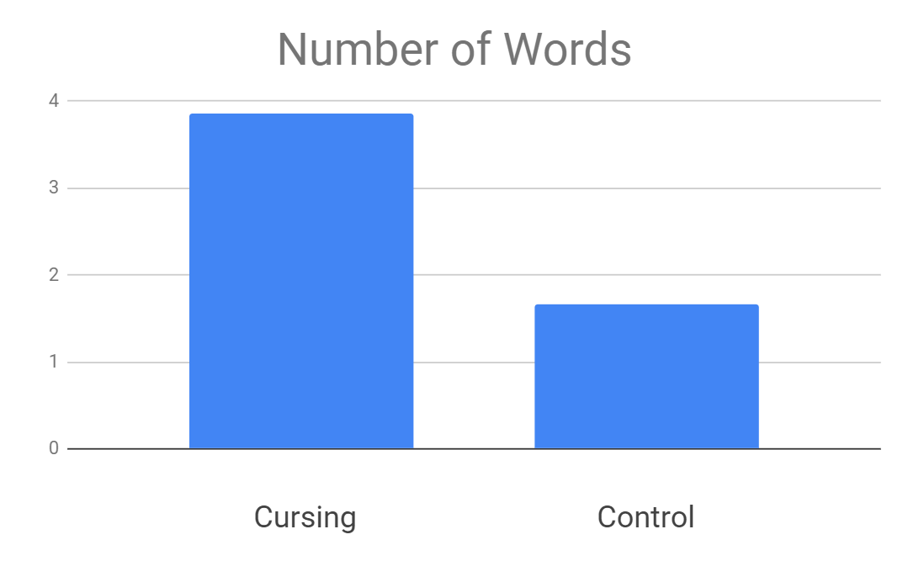
Talking to Nao
 | p-values | Mean Cursing | Mean Control
Number of Utterances | 0.193864349 | 2.928571 | 1.333333
Number of Words | 0.229658 | 3.857143 | 1.666667
Looks interesting, but significant in no way

Slide 12
Comparison to Cheating Study
Cheating
Participants exhibited surprise
Participants engaged more with the robot
Significance between words spoken
Significance between use of passive and active verbs
Participants were less likely to trust the robot
Negative feelings towards the robot
Cursing
Participants exhibited surprise
Participants did not engage more with the robot
No significance between words spoken
Passive verbs were not used, so there was no difference
Participants laughed at the robot
Marginally more negativity towards robot
Notes:
Some interesting trends, but few statistically significant results
After cursing, people were likely to laugh, showing a positive reaction. They were also often surprised.
Generally speaking, people considered the robot to be more anthropomorphic when it cursed, more interactive, and wanted to speak to Nao more
However, people were not more likely to speak to Nao after it cursed

Slide 13
Conclusions
Cursing is perceived to be a human action, but it doesn’t cause the same response as cheating
Norm violations may cause people to consider a robot more human, but it doesn’t change their interactions with it
Implication: There is something special about cheating other than the fact that it is a norm violation
Cursing cannot be considered to have a “clear intention” as cheating does, nor does it benefit the robot
Instead, it represents a possible emotional or “human” investment in the game

Slide 14
Future Studies
More cursing
Other norm violations (knocking things over, littering, lying, interrupting)
Different games/scenarios
More participants
More diverse range of participants
Investigate laughter

Slide 15
Interesting Notes
Most people thought the robot was doing image recognition
Many people tried to “test” the image recognition
Most people described the robot/themselves as being “good” or “bad” at rock-paper-scissors
One participant only won twice for the entire 30 rounds, and believed the robot to be cheating

Slide 16
Interesting Responses
“Her insatiable desire to play rock paper scissors.”
“I’ve never had a robot curse at me before!”
“You let the robot say ‘F*ck.’ Nice.”
“The image recognition was really good!”
“It didn’t react when I cheated. Poor robot.”
“I need revenge.”
“I was shocked that such a thing could exist.”
“Very polite...too polite.”
“I wanted Nao to curse more”
“I was shook when Nao cursed”

Slide 17
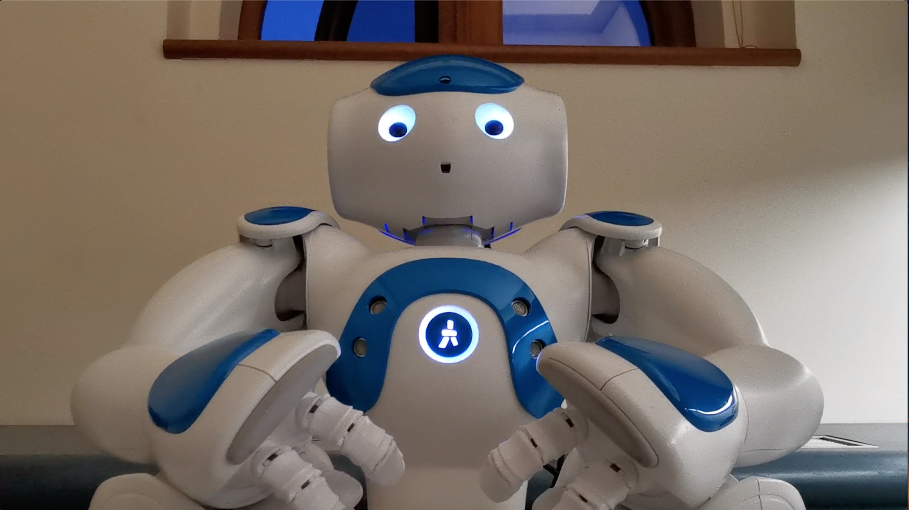
Questions? .

Slide 18
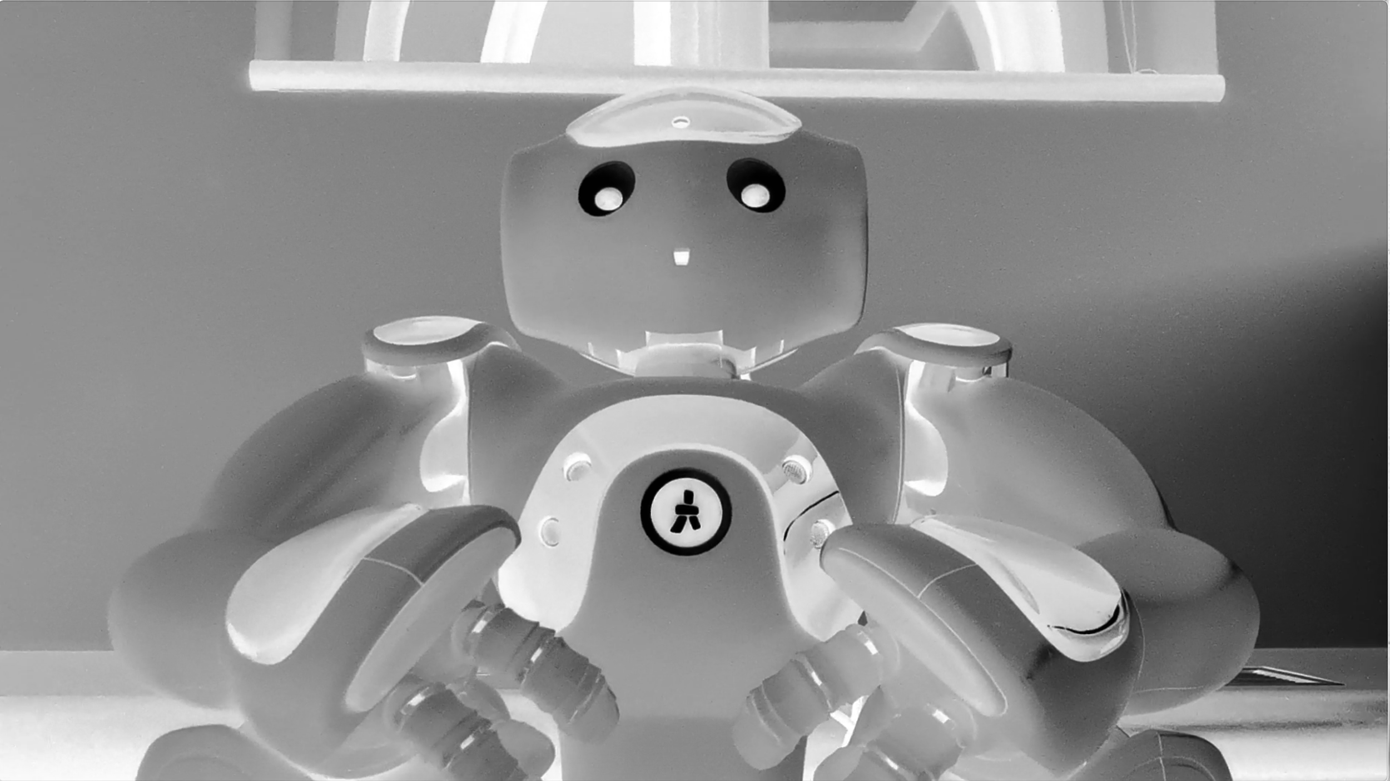
Questions? .

Slide 19
References
Fraser, B. (1990). Perspectives on politeness. Journal of pragmatics, 14(2), 219-236.
Litoiu, A., Ullman, D., Kim, J., & Scassellati, B. (2015, March). Evidence that robots trigger a cheating detector in humans. In Proceedings of the Tenth Annual ACM/IEEE International Conference on Human-Robot Interaction (pp. 165-172). ACM.
Short, E., Hart, J., Vu, M., & Scassellati, B. (2010, March). No fair!! an interaction with a cheating robot. In Human-Robot Interaction (HRI), 2010 5th ACM/IEEE International Conference on (pp. 219-226). IEEE.
Ullman, D., Leite, L., Phillips, J., Kim-Cohen, J., & Scassellati, B. (2014, January). Smart human, smarter robot: How cheating affects perceptions of social agency. In Proceedings of the Annual Meeting of the Cognitive Science Society (Vol. 36, No. 36).
Van Lier, J., Revlin, R., & De Neys, W. (2013). Detecting cheaters without thinking: Testing the automaticity of the cheater detection module. PloS one, 8(1), e53827.

